Slide 1
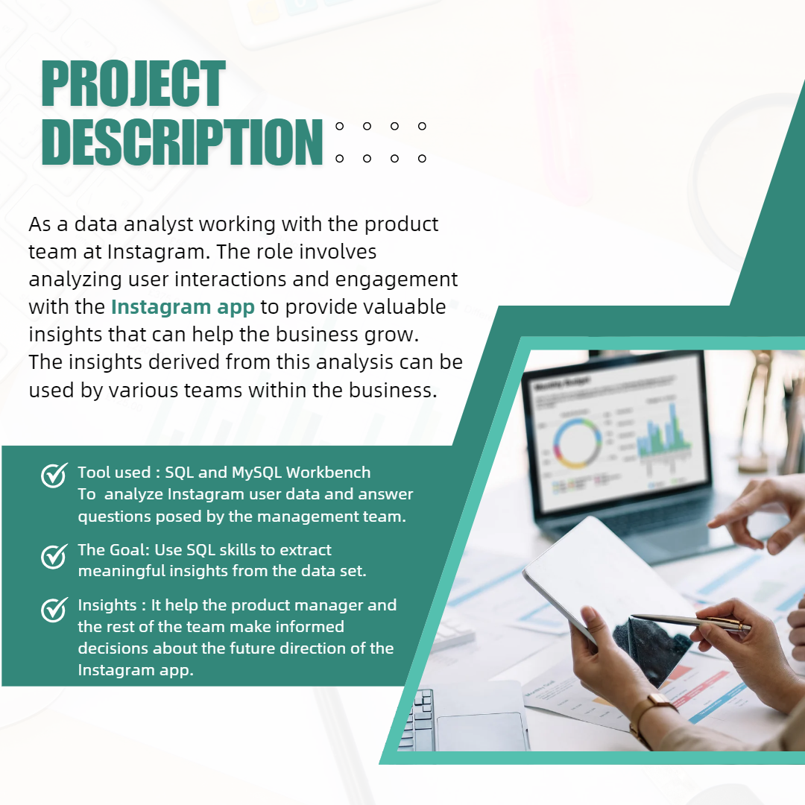
Instagram User Analytics

Slide 2
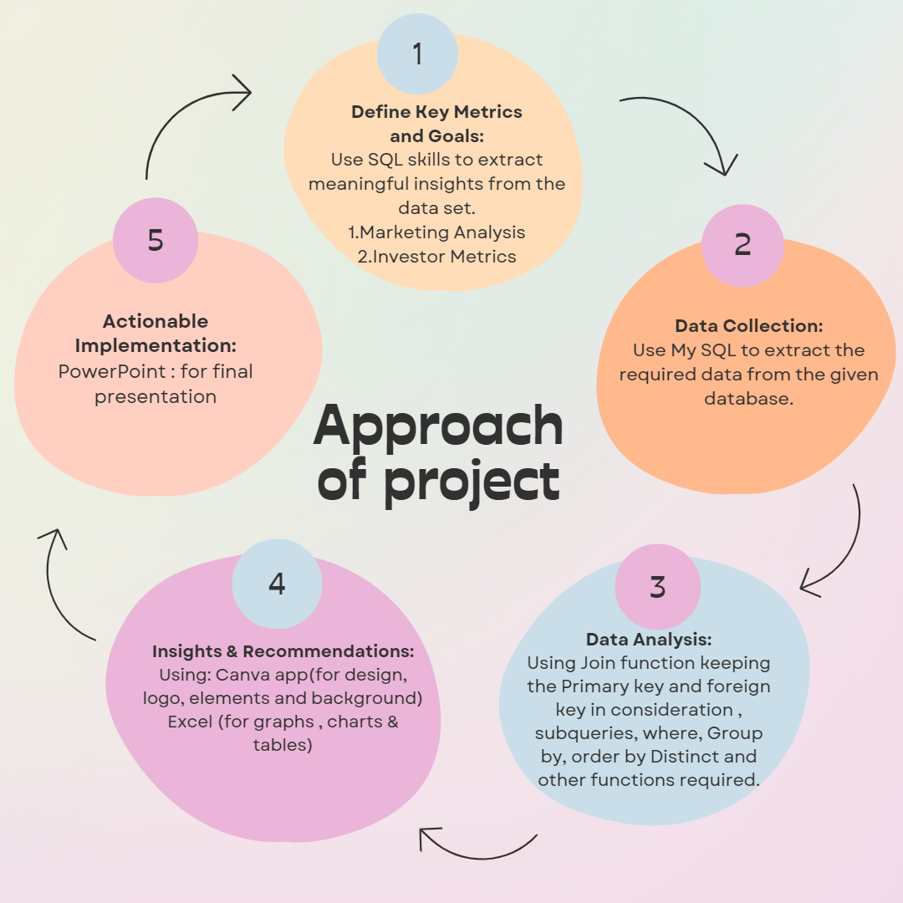

Slide 3


Slide 4
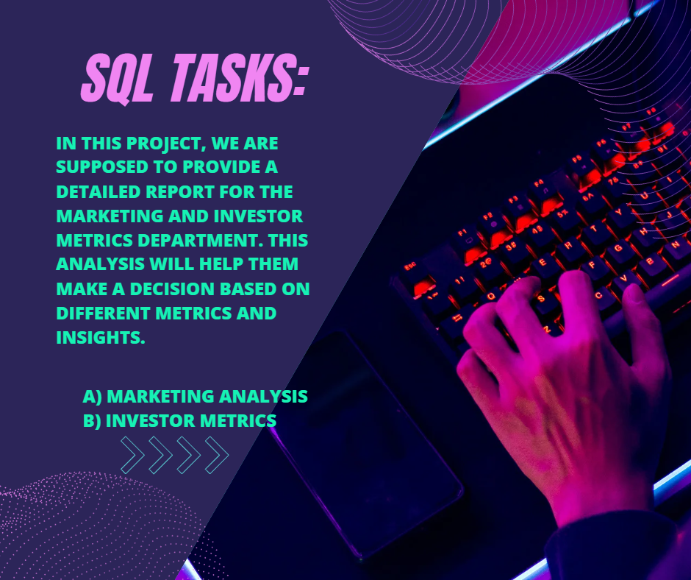

Slide 5


Slide 6
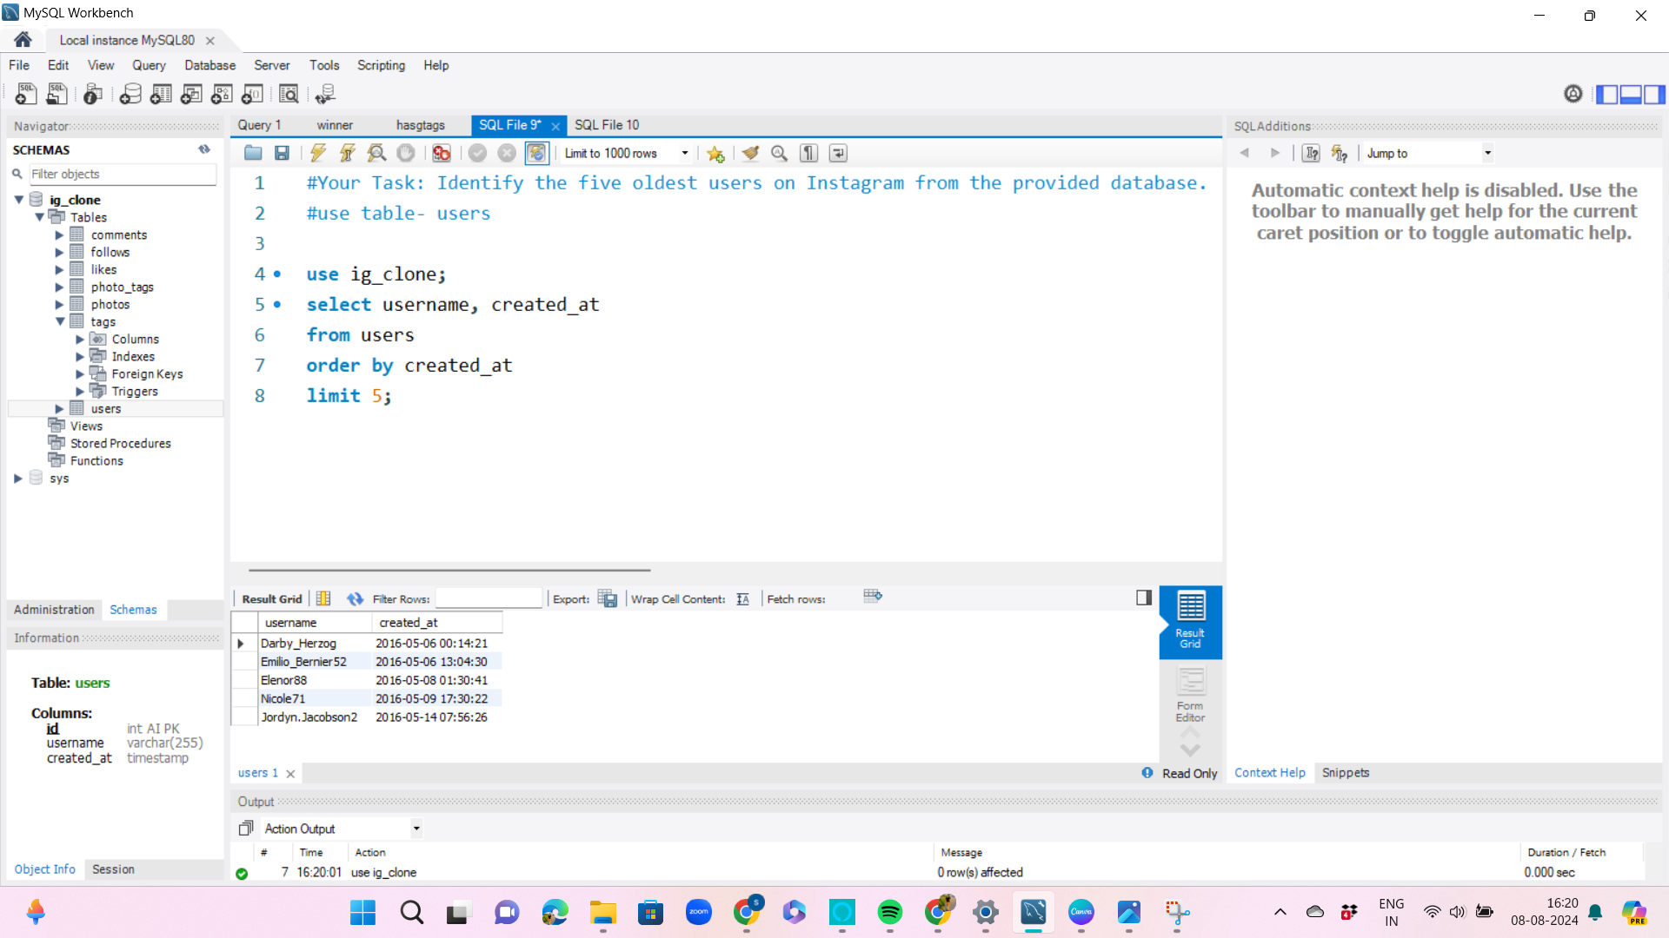

Slide 7


Slide 8
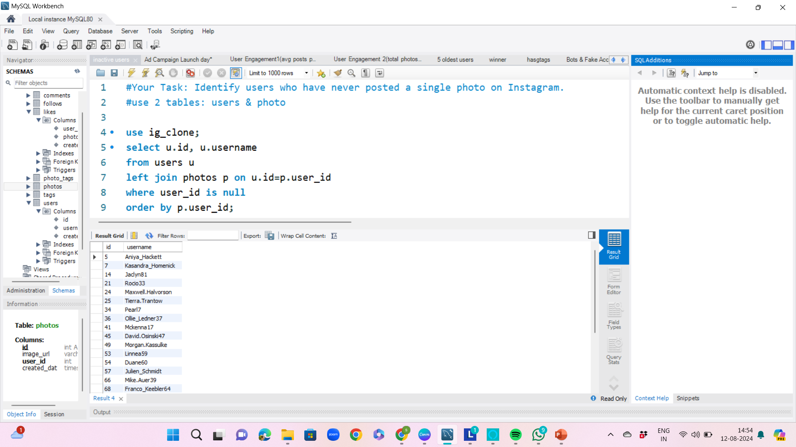

Slide 9
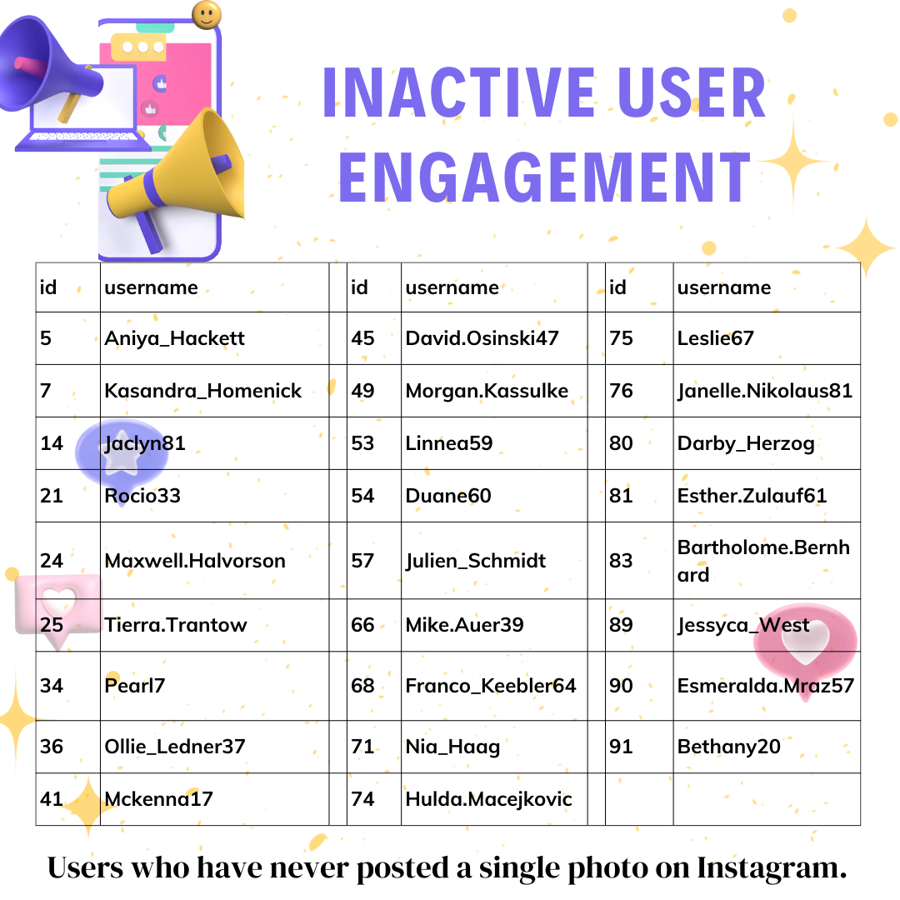

Slide 10
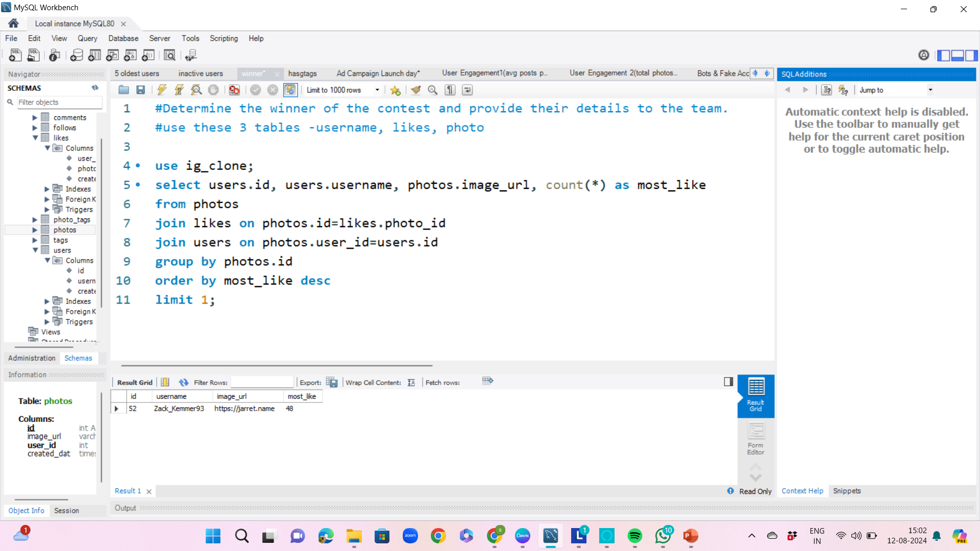

Slide 11


Slide 12
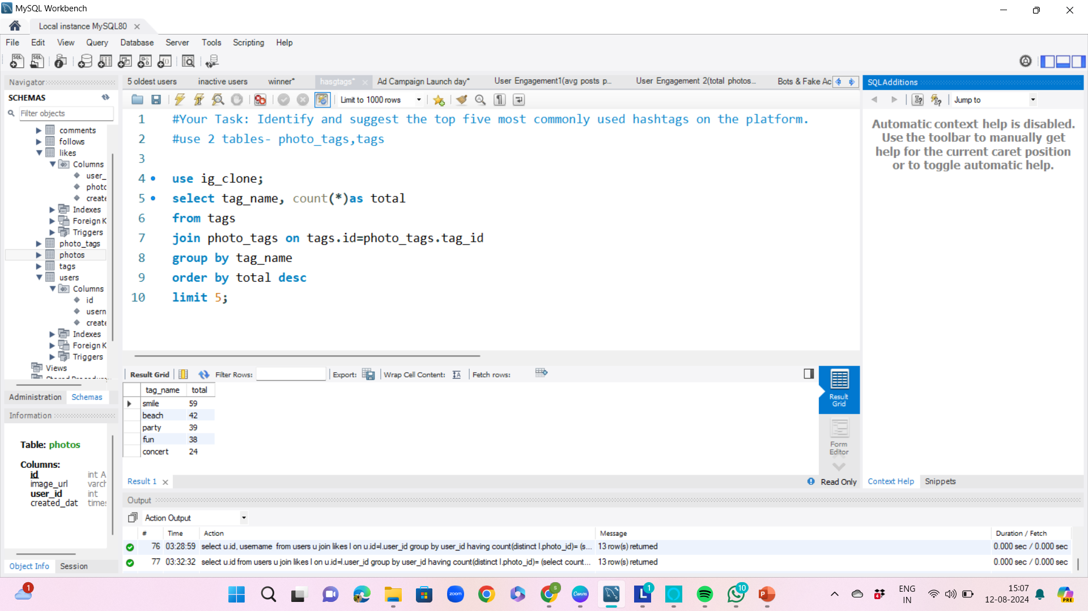

Slide 13


Slide 14
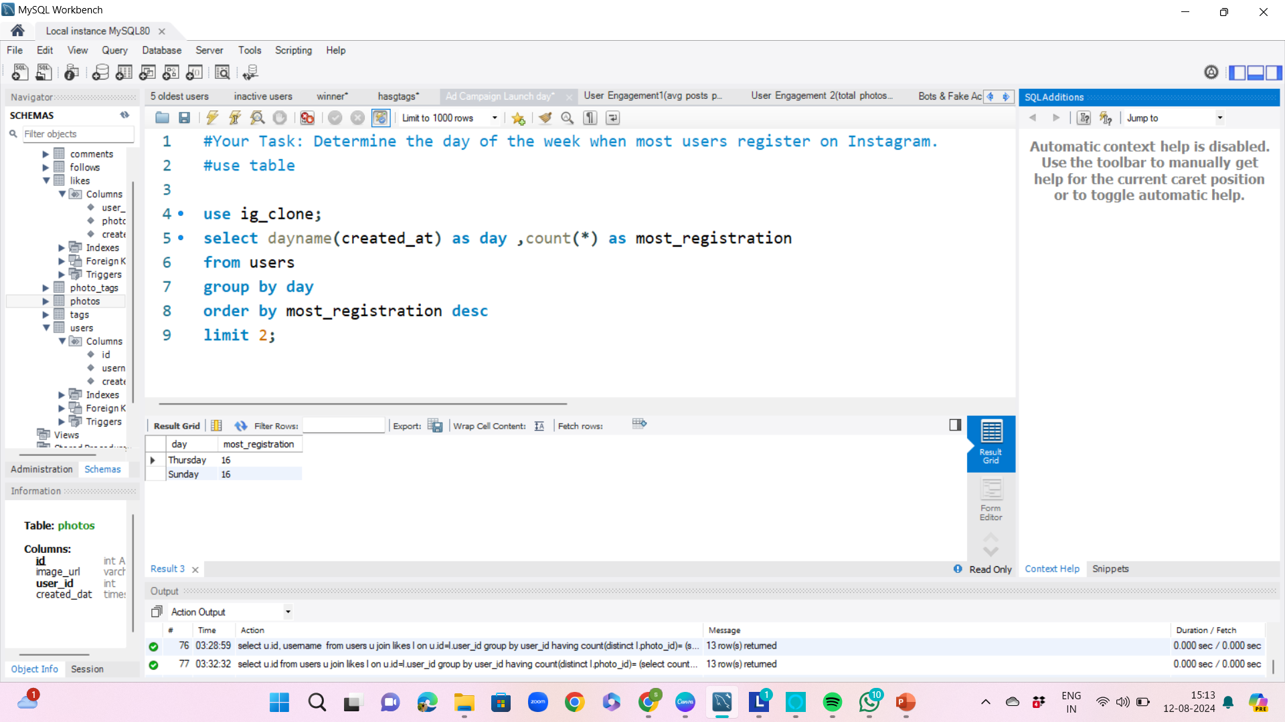

Slide 15
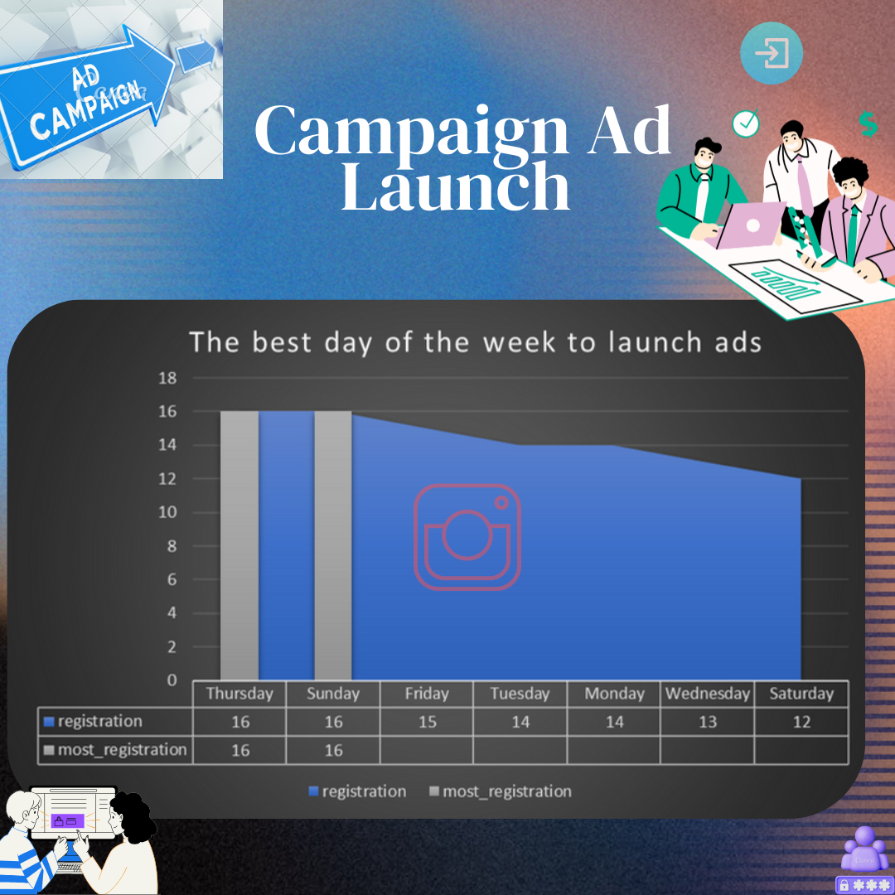

Slide 16


Investor Metrics
1.User Engagement
2.Bots & Fake Accounts
Investors want to know if users are still active and posting on Instagram or if they are making fewer posts. Your Task: Calculate the average number of posts per user on Instagram. Also, provide the total number of photos on Instagram divided by the total number of users.
Investors want to know if the platform is crowded with fake and dummy accounts. Your Task: Identify users (potential bots) who have liked every single photo on the site, as this is not typically possible for a normal user.

Slide 17
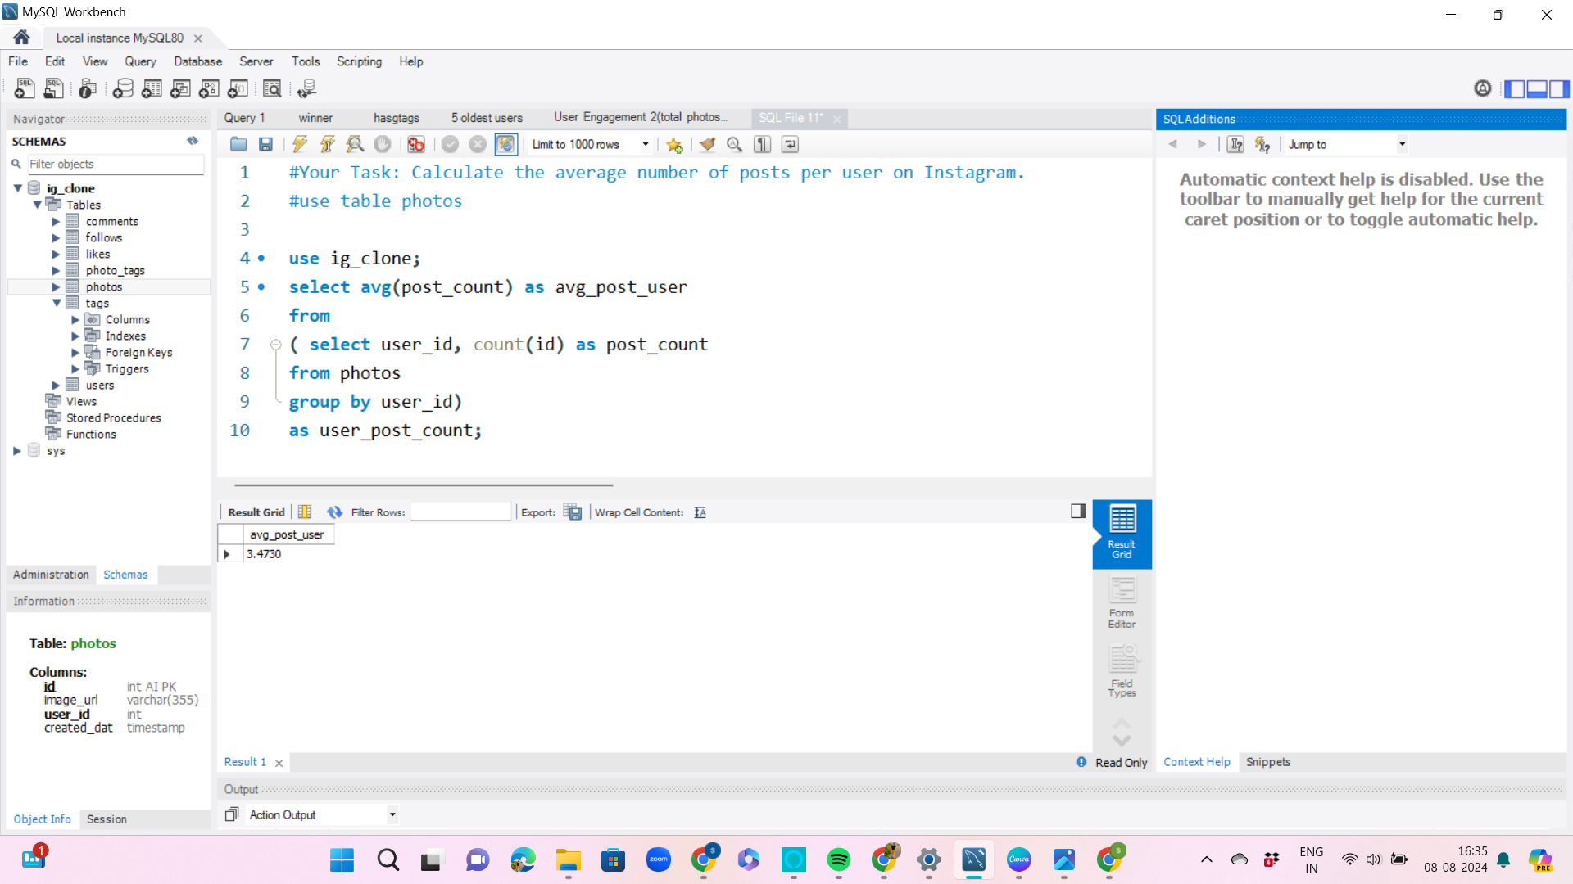

Slide 18
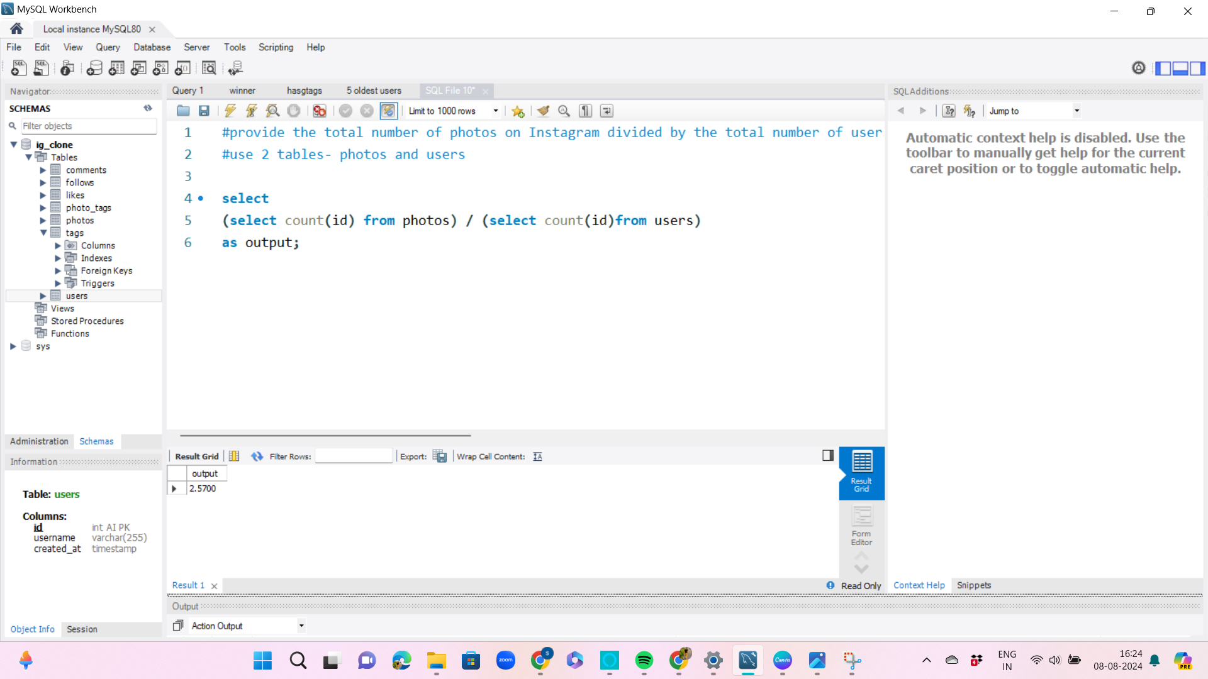

Slide 19
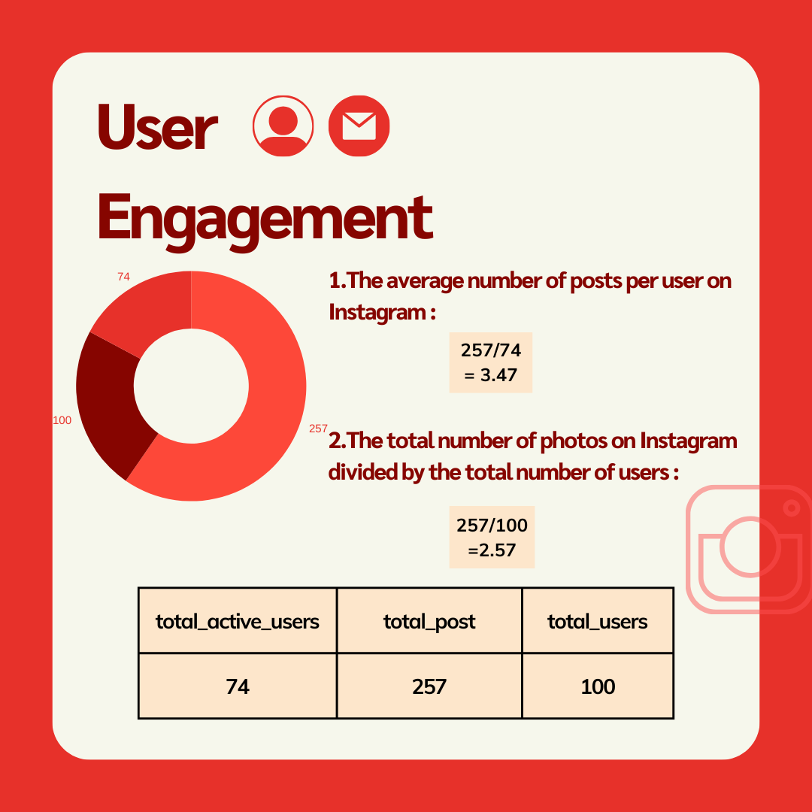

Slide 20
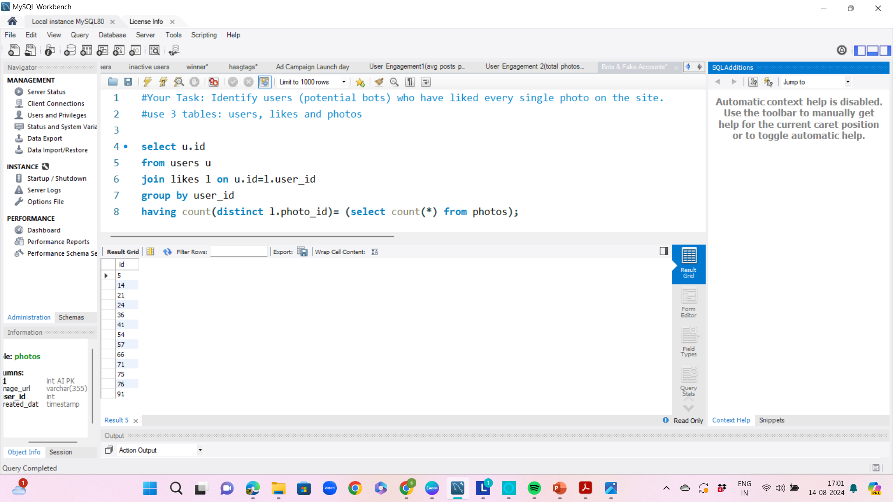

Slide 21


Slide 22
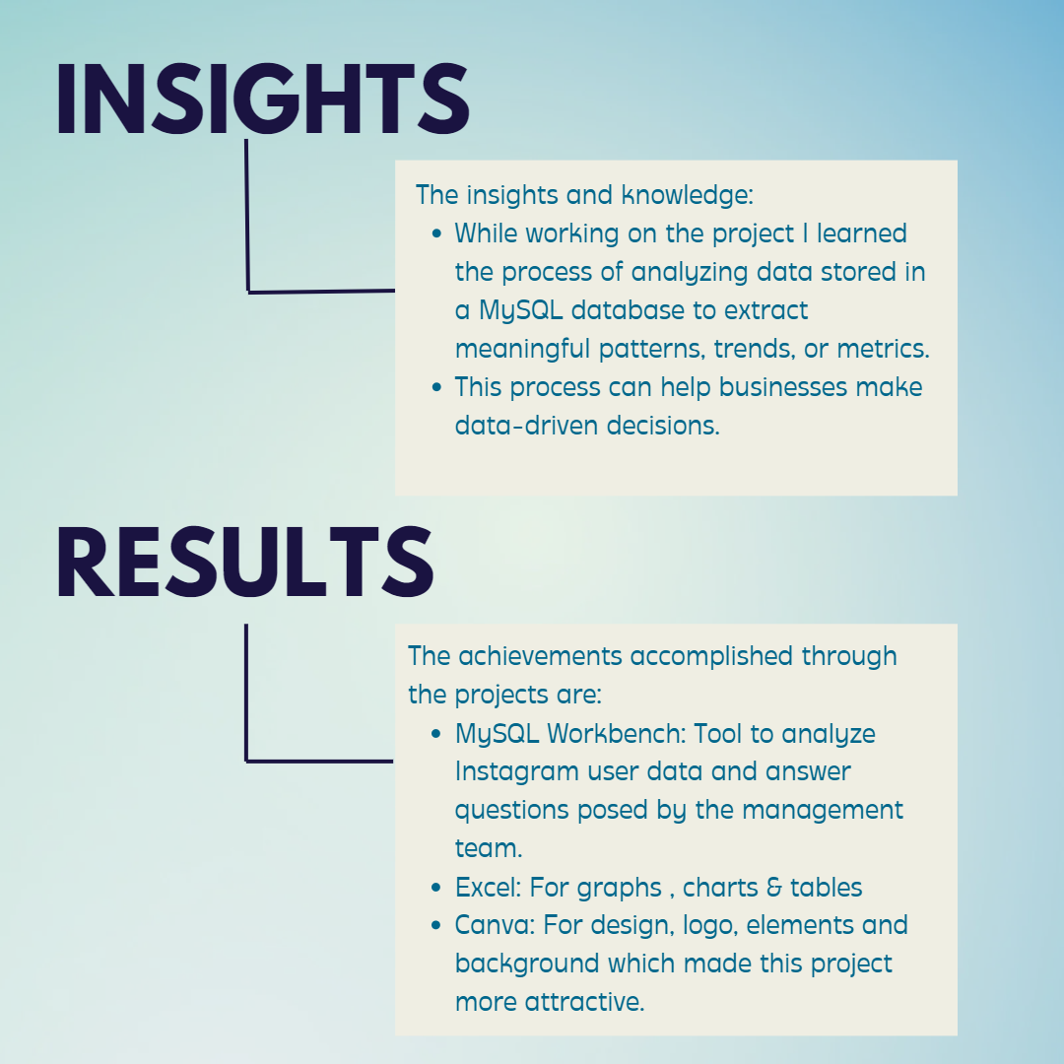

Slide 23


